Slide 1
Introduction to Research Work
Research on Improved YOLOv5s for Defect Detection of Steel
Group Name: You Only Live Once
Group Members: Haotian Du (Rocky), Yifan Li (Charles), Yuxin Cao (Allen)
Group Leader: Haotian Du (Rocky)

Slide 2
Outline
Group Inseption
Reseach Topic
Introduction
Timeline
Research Questions or Hypotheses
Research Objectives
Literature Review
Research Methods
Design and Steps
Experiments
Results
Further Improvement
References

Slide 3
Group Inspection

Slide 4
Group members and their contribution
Member Name | Contribution to the Research
Haotian | Review, Coding, Software Copyright, Report
Yifan | Review, Testing, Report
Yuxin | Review, Data Collection, Report

Slide 5
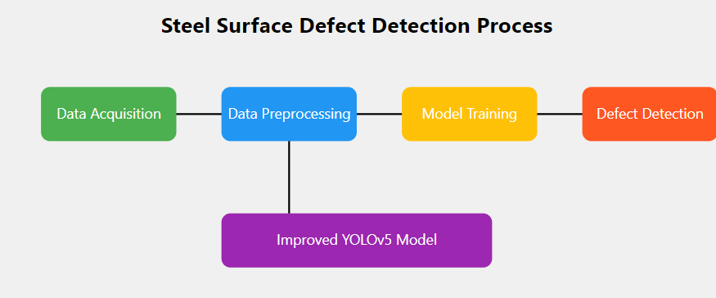
Reseach Topic
Development of Automated Steel Surface Defect Detection Software Based on an Improved YOLOv5 Model

Slide 6
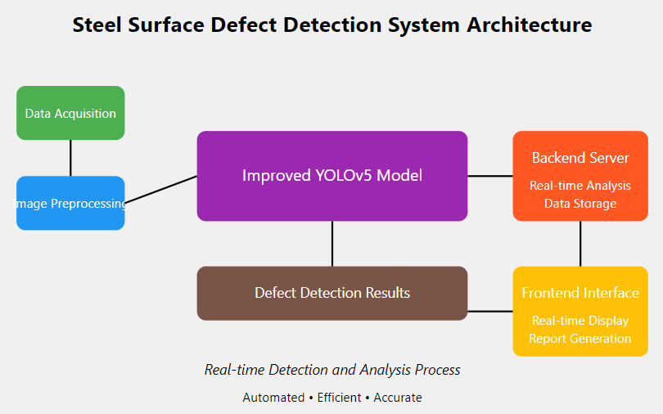
Introduction
Defect detection on steel surfaces is a critical task in the manufacturing industry to ensure product quality.
Traditionally, this task has been performed manually, which is time-consuming, prone to human error, and inconsistent. Automated defect detection using computer vision and deep learning techniques provides significant advantages, including faster inspection times, improved accuracy, and the ability to operate continuously without fatigue.
This research focuses on developing a software product for detecting steel surface defects using an improved version of the YOLOv5 model, combined with a seamless front-end and back-end interactive system for real-time analysis and reporting.

Slide 7
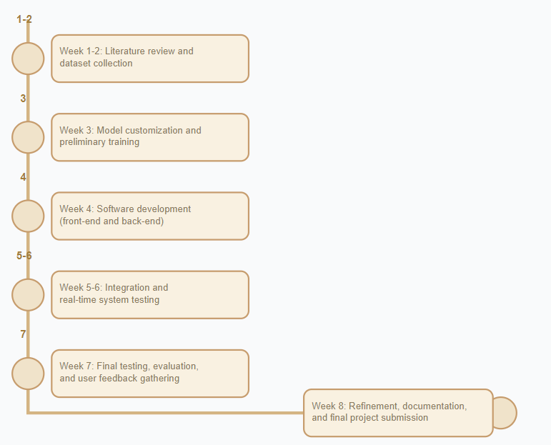
Timeline
Week 1-2: Literature review and data collection.
Week 3: Model customization and preliminary training.
Week 4: Software development (front-end and back-end).
Week 5-6: Integration and real-time system testing.
Week 7: Final testing, evaluation, and user feedback gathering.
Week 8: Refinement based on feedback, documentation, and final project submission.

Slide 8
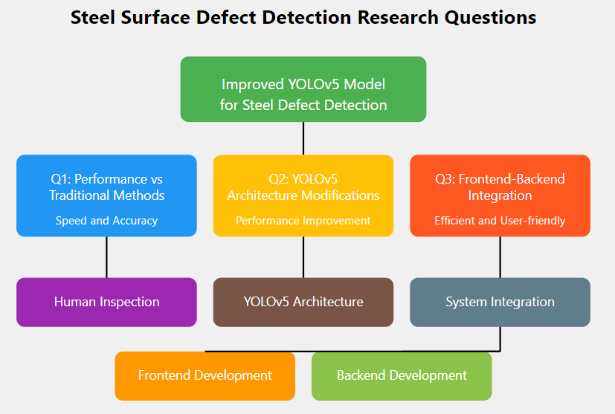
Research Questions or Hypotheses
Can an improved YOLOv5-based model outperform traditional manual inspection in terms of speed and accuracy for detecting steel surface defects?
What modifications to the YOLOv5 architecture can enhance the model’s performance for defect detection?
How can front-end and back-end technologies be integrated to create an efficient, user-friendly interface for defect detection in industrial environments?

Slide 9
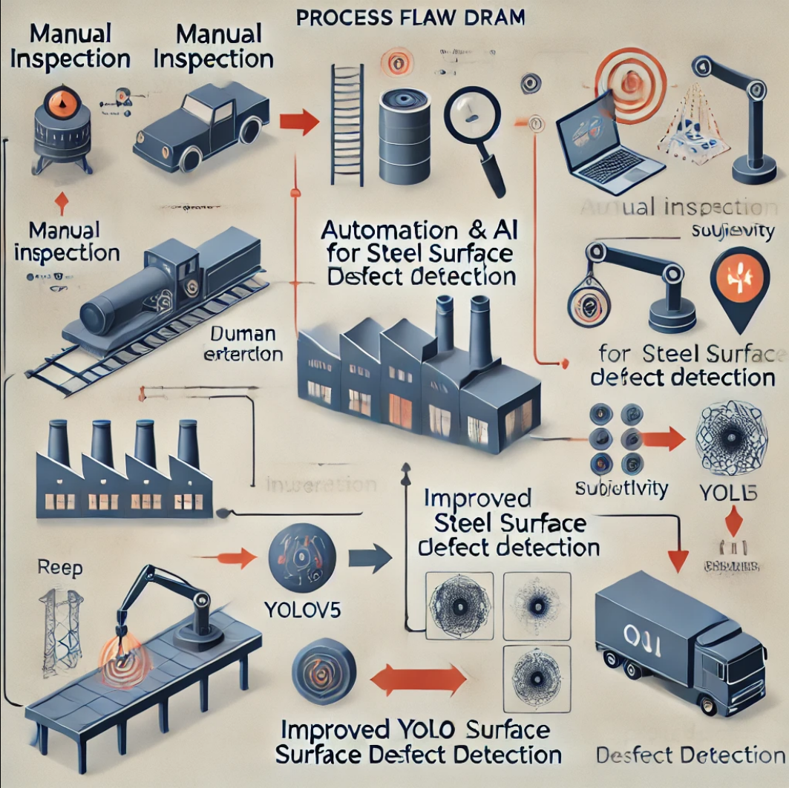
Research Objectives
To design and implement an automated steel surface defect detection system based on an enhanced YOLOv5 model.
To compare the performance of the proposed system with traditional manual inspection methods in terms of accuracy, speed, and efficiency.
To develop a user-friendly software interface that allows real-time interaction between the user and the system, utilizing both front-end and back-end technologies.

Slide 10
Literature Review
The literature review will cover previous work on defect detection methods in industrial contexts, focusing on deep learning approaches like YOLO (You Only Look Once) and other object detection models.
The review will also examine manual inspection limitations and the growing adoption of automation and artificial intelligence (AI) in quality control processes. It will highlight recent advancements in YOLOv5, its applications, and various improvements that can be made to its architecture to suit specific tasks such as defect detection.

Slide 11
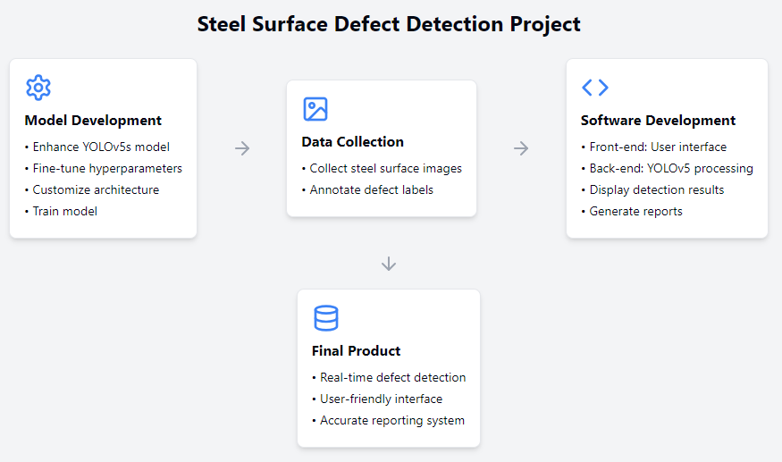
Research Methods
Model Development and Improvement: The core of this project involves enhancing the YOLOv5s model for steel surface defect detection. This will include fine-tuning the model's hyperparameters, customizing the architecture to improve detection of small or complex defects, and training the model using a dataset of steel surface images with labeled defects.
Data Collection: A dataset of images representing different types of steel surface defects will be collected from industrial sources or generated through controlled simulations. The dataset will be annotated with defect labels to train and evaluate the model.
Software Development: The software will use front-end and back-end technologies to allow users to upload images of steel surfaces, view real-time detection results, and generate reports. The back-end will manage the YOLOv5 model's processing, while the front-end will provide an intuitive interface for users.

Slide 12
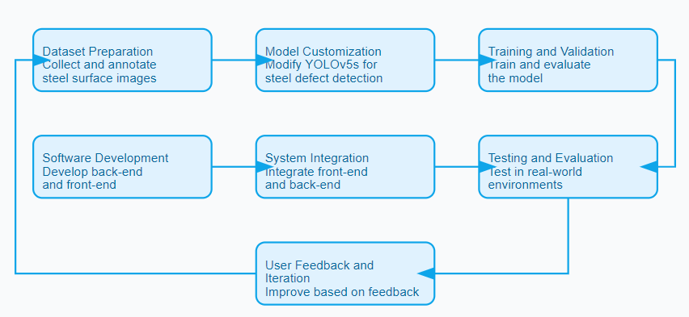
Design and Steps
Dataset Preparation: Collect and annotate steel surface images representing various defects (e.g., cracks, corrosion, scratches).
Model Customization: Modify the YOLOv5s architecture to optimize it for detecting steel surface defects. This may involve adjustments such as adding custom layers, modifying anchor boxes, or improving the loss function.
Training and Validation: Train the improved YOLOv5 model using the prepared dataset, and validate its performance using standard metrics like precision, recall, and F1 score.
Software Development: Develop the back-end using technologies such as Python, Flask/Django to run the model, and the front-end using frameworks like React or Vue.js to display results.
System Integration: Integrate the front-end and back-end to enable smooth communication between the user interface and the YOLOv5 model, ensuring real-time defect detection.
Testing and Evaluation: Test the software in real-world environments to evaluate its performance and compare it with traditional manual inspection methods.
User Feedback and Iteration: Gather feedback from users in industrial settings and iteratively improve the software product based on this feedback.

Slide 13
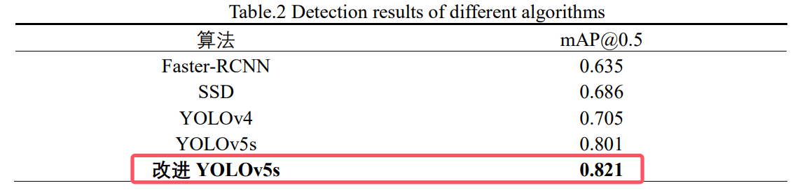
Experiments
The data will be analyzed through metrics such as mean Average Precision (mAP), detection speed (inference time), and real-world applicability (based on feedback from field tests).
The improved YOLOv5 model’s performance will be benchmarked against the original YOLOv5 and manual inspection results. We will use confusion matrices, precision-recall curves, and other statistical tools to evaluate and compare results.

Slide 14
Results
The research is expected to yield an automated defect detection system that surpasses traditional manual methods in terms of speed and accuracy. The improved YOLOv5 model should demonstrate high precision and recall in detecting a variety of surface defects.
The final product will provide a user-friendly interface that integrates back-end processing and real-time interaction with the system, making it a valuable tool for quality control in the steel manufacturing industry.

Slide 15
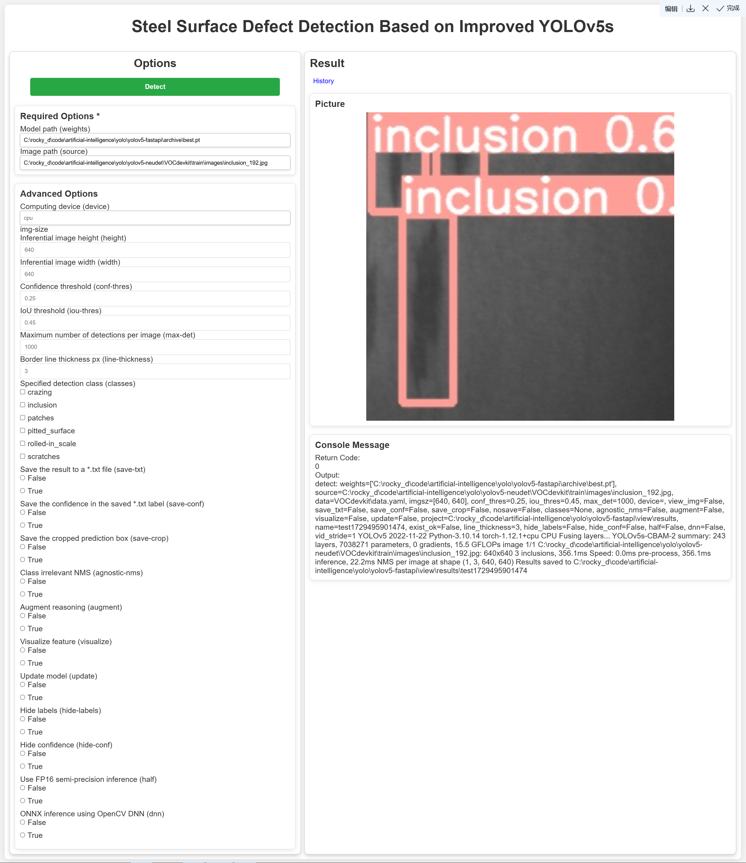
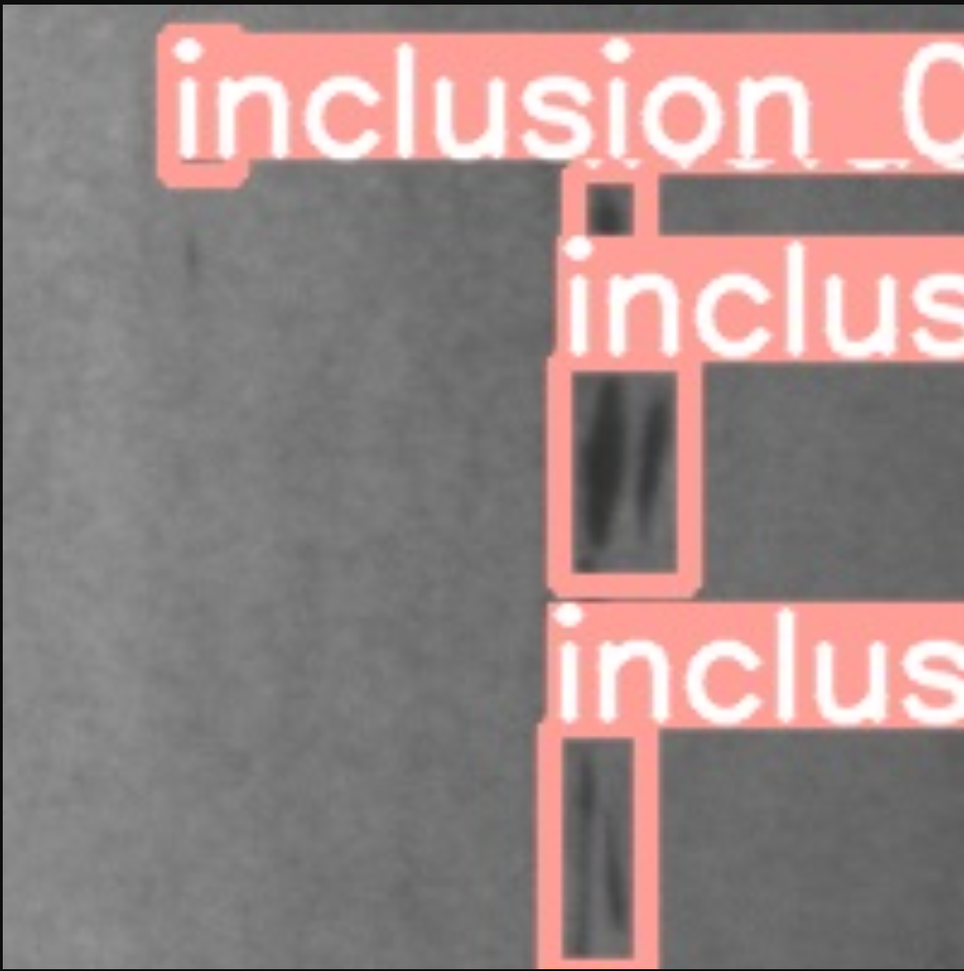
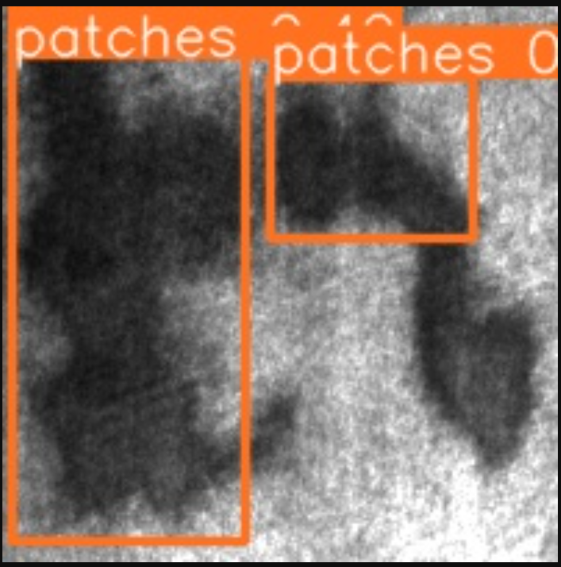
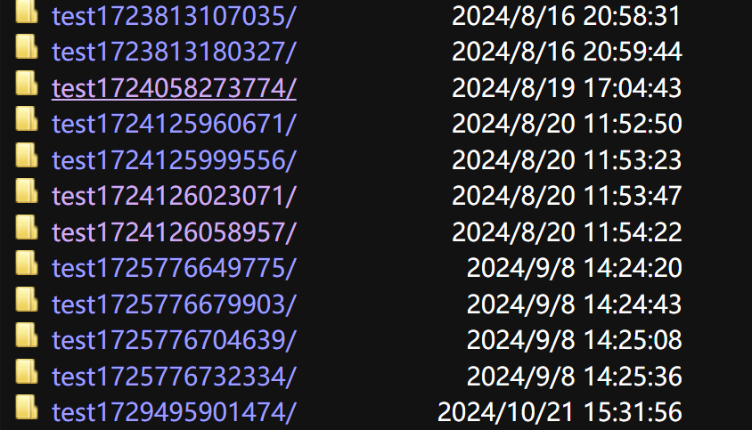
Results

Slide 16
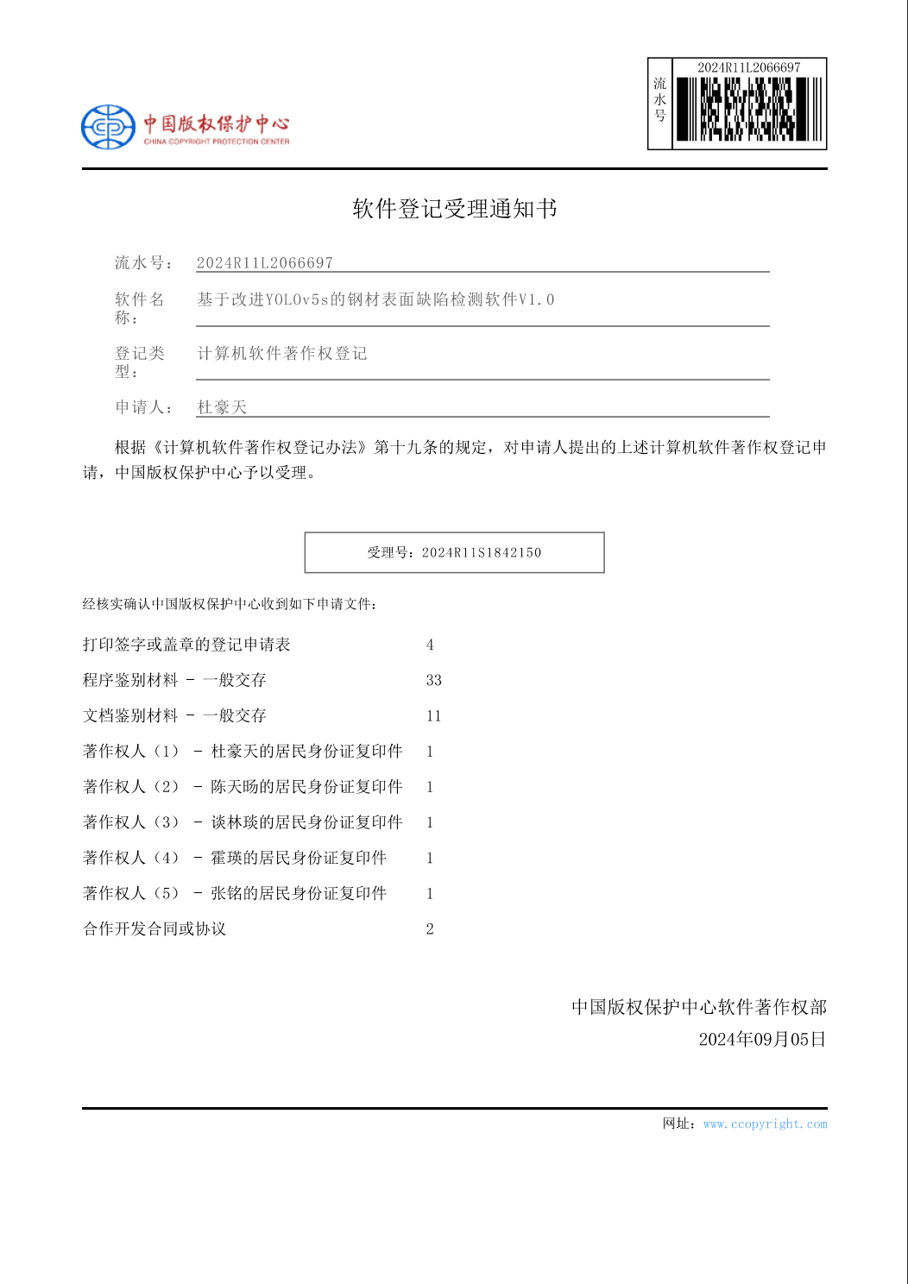
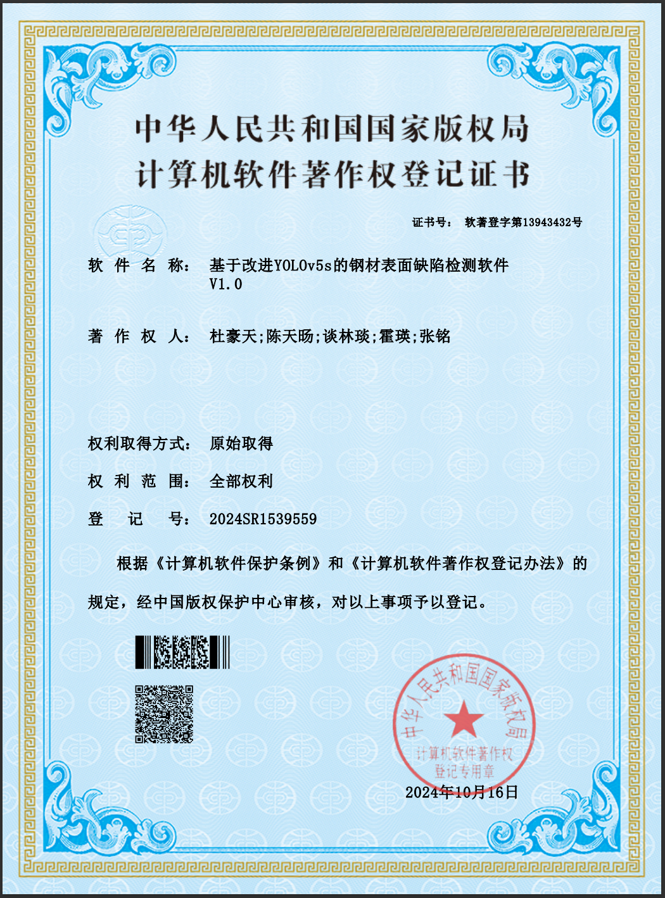
Results

Slide 17
Further Improvement
Move user-friendly.
More functionalities.
Precision.

Slide 18
References
Hevner, A. R., March, S. T., Park, J., & Ram, S. (2004). Design science in information systems research. MIS Quarterly, 28(1), 75-105.
2. Benbasat, I., & Zmud, R. W. (2003). The identity crisis within the IS discipline: Defining and communicating the discipline's core properties. MIS Quarterly, 27(2), 183-194.
Ally M , Darroch F , Toleman M .A Framework for Understanding the Factors Influencing Pair Programming Success[J].Springer, Berlin, Heidelberg, 2005.DOI:10.1007/11499053_10.
Choi K S , Deek F P , Im I .Exploring the underlying aspects of pair programming: The impact of personality[J].Information & Software Technology, 2008, 50(11):1114-1126.DOI:10.1016/j.infsof.2007.11.002.
Glaser B G .The Constant Comparative Method of Qualitative Analysis[J].Social Problems, 2008, 7(4):436-445.DOI:10.1525/sp.1965.12.4.03a00070.

Slide 19
End

